Slide 1
EDCU12039 Design and Digital Technologies: Assessment 2
Fern Albery-S0255809 Tess Downes-S0240442 Matthew Kelly-S0244955

Slide 2
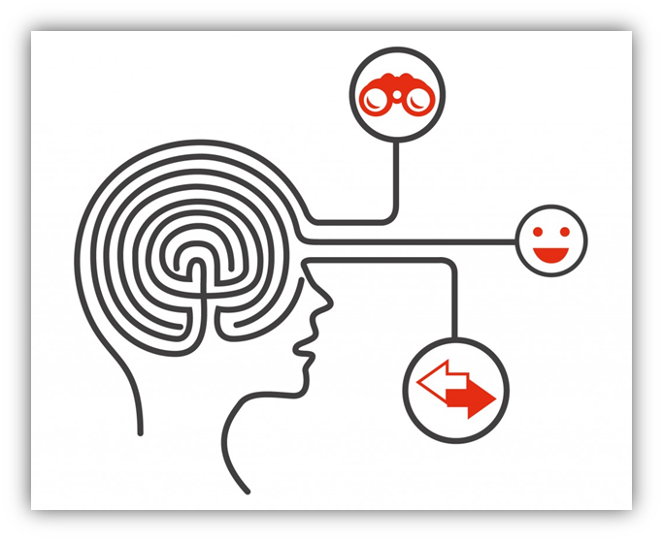
This Presentation Will Show How ICT Can Enhance Thinking, Collaboration And Problem-solving Skills And Capabilities To Achieve The Criteria Within The Design Cycle

Slide 3
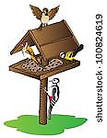
The Year 5 and 6 students surveyed the school community.
The survey identified that:
The number one idea to enhance the school environment was to incorporate bird feeders.
Notes:
Image retrieved from Clip art.

Slide 4
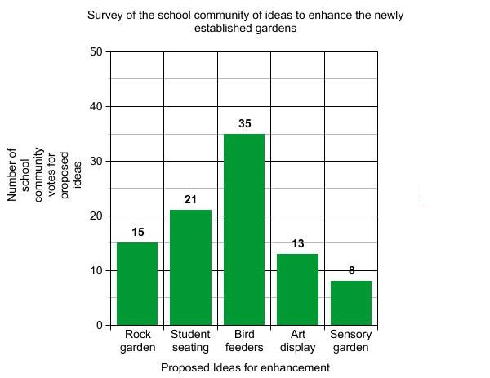
Data
Students will collate and interpret the survey data.
Students will use the data to create a graph using ‘Kid Zone Graph Maker’.
This encourages problem-solving skills, creative and innovative thinking, as well as inventiveness through presentation of authentic, real problems and issues.
Notes:
Graph constructed using create a graph on the Kids Zone website. http://nces.ed.gov/nceskids/createagraph/default.aspx?ID=bf918cb7aa1c4392868447d7619863f4

Slide 5
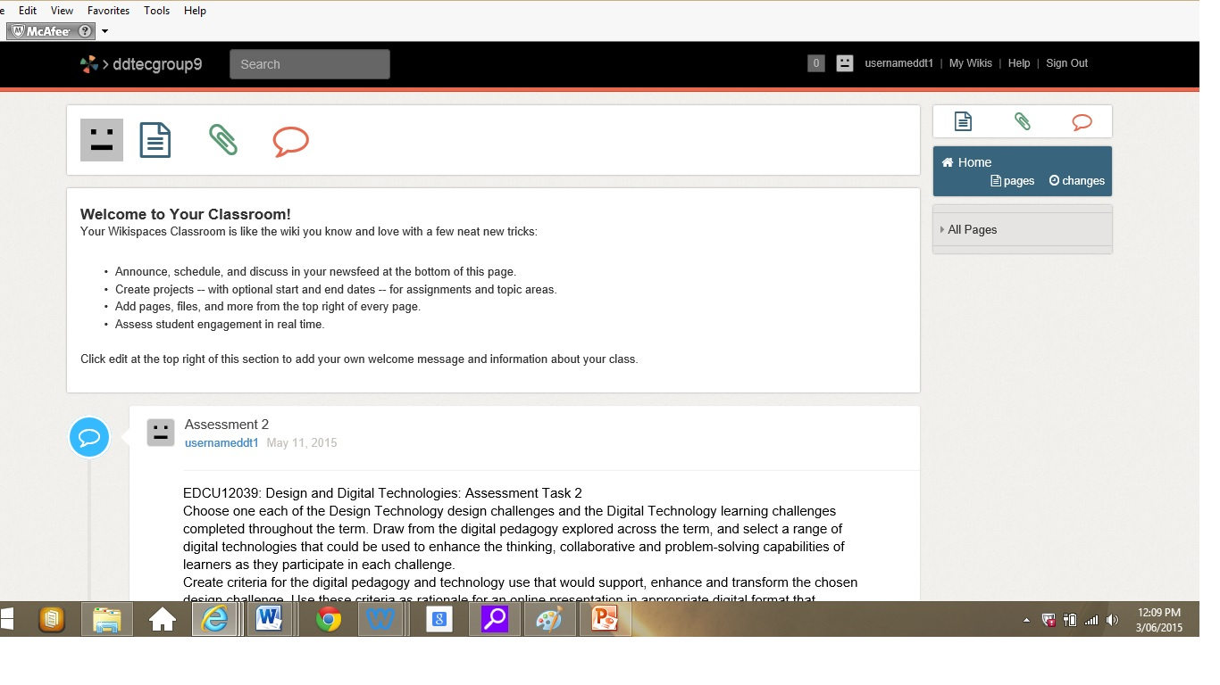
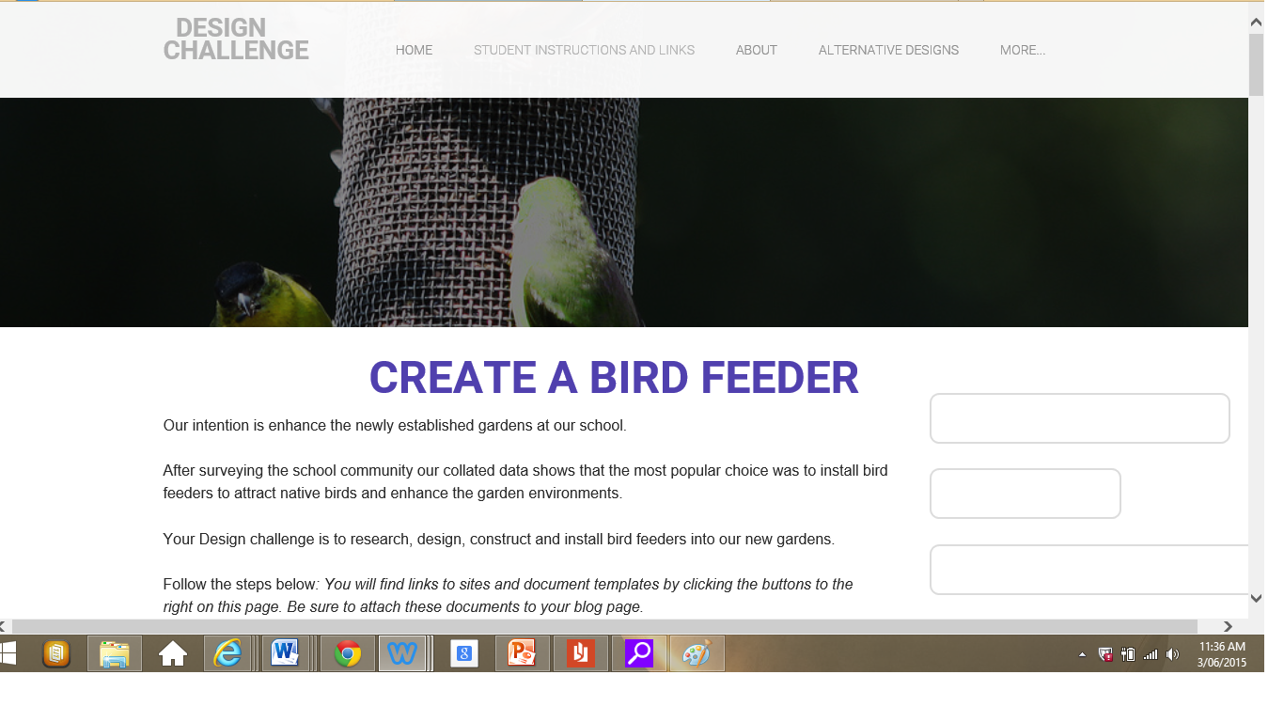
Design Cycle The students will follow the ﻿design cycle to research, design, construct, evaluate and then install the bird feeders into the newly established gardens.
The first process is for students in groups of four to set up a group ‘Wiki’, where they will collaborate and share ideas. Students are also instructed to set-up an individual ‘Blog’ page, for presenting learning, ideas and reflections throughout the process.
These tasks facilitate students to use ICT to demonstrate knowledge and understanding through the use of technology. This is essential as using ICT to problem-solve assists learners to develop cognitive abilities and enhance their educational outcomes.

Slide 6
Students will complete
Needs Analysis
Research and choose a design for a bird feeder.
Complete a Design Matrix for their chosen design
Students are to ensure that their design specifications meet the criteria:
Relocatable
Has perches
Can hold the weight of more than one bird, bird seed and a water container
The feeder will be approximately 1 meter in height
It will consist of base, body, top
Materials used will include a pot, chair legs or tomato stakes, sand, recycled containers eg; bowls, side plates (china, melamine, plastic), paint, paint brushes, glue, design template.
You will have approximately four hours to complete
Details you must also consider:
Your design must compliment the surrounding environment and be aesthetically pleasing.
Should be easily disassembled
Must be weather resistant
These tools enable students to assess a problem and experiment with possible solutions. Problem-solving is valuable to both individual and collaborative learning; students can brainstorm and share knowledge and reflect upon their previous representations.

Slide 7
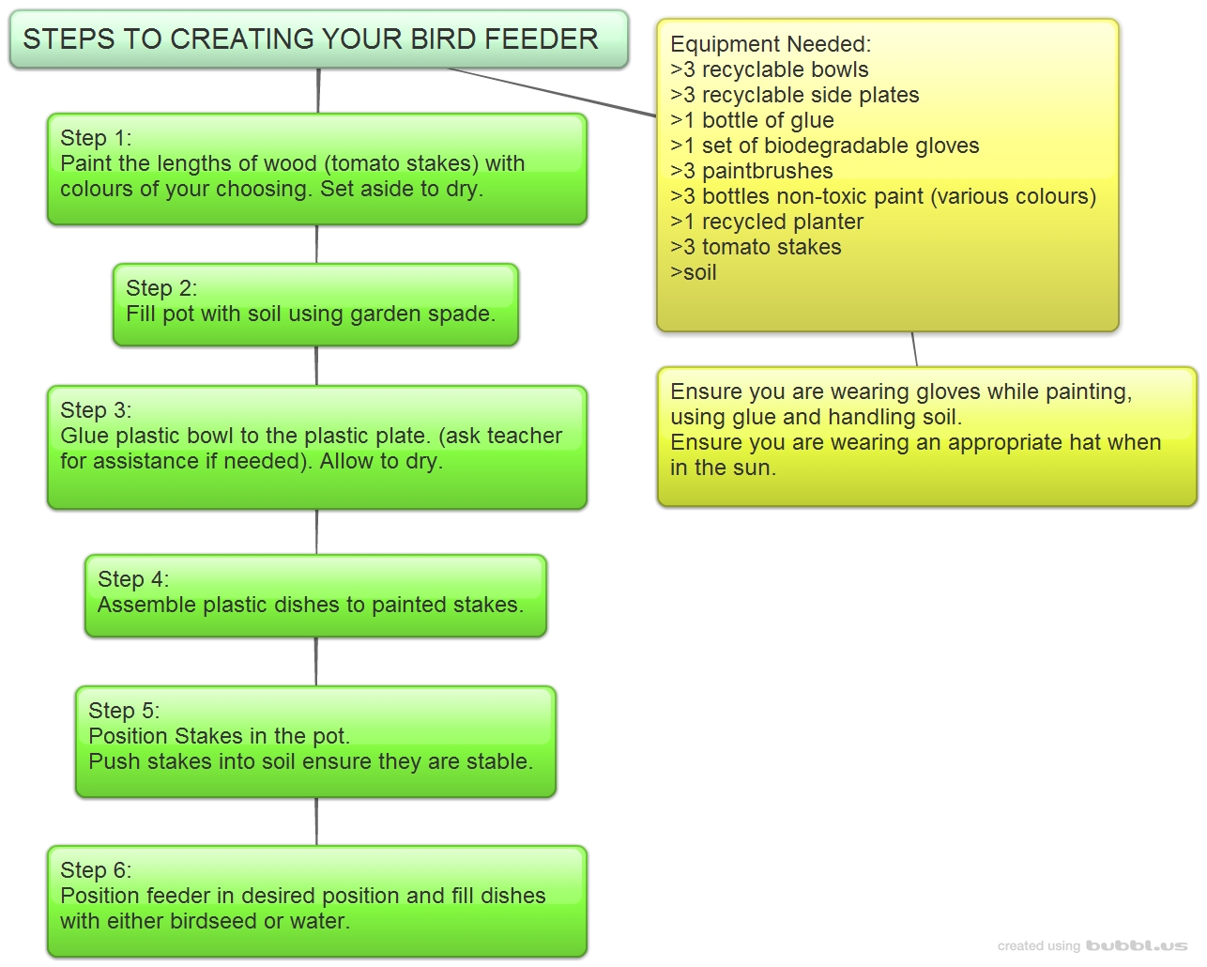
Students will create
A mind map using the site ‘Bubble.us’. Students will identify and display the steps, procedures and materials used in the design cycle.
This will encourage higher order thinking, knowledge construction and promote beneficial ICT skills in students.

Slide 8
Reflection and Evaluation
After final construction of the bird feeders, students will return to their individual blog page and display documents, images and pictures. This will illustrate the design process and demonstrate students thinking throughout the design challenge stages.
Students will also be asked to submit a reflection documenting their personal learning journey; they will reflect on their enjoyment, their ability to collaborate, what they would do differently and what they learnt throughout the process.
When asking students to complete the blog, it is not only a way of assisting students to present learning, but will also provide the teacher with evidence of students learning and understanding.

Slide 9
Implementation of this design challenge will contribute to achieving the following Content Descriptions in Design and Technologies:
Investigate characteristics and properties of a range of materials, systems, components, tools and equipment and evaluate the impact of their use (ACTDEK023)
Critique needs or opportunities for designing, and investigate materials, components, tools, equipment and processes to achieve intended designed solutions (ACTDEP024)
Generate, develop, communicate and document design ideas and processes for audiences using appropriate technical terms and graphical representation techniques (ACTDEP025)
Apply safe procedures when using a variety of materials, components, tools, equipment and techniques to make designed solutions (ACTDEP026)
Negotiate criteria for success that include consideration of sustainability to evaluate design ideas, processes and solutions (ACTDEP027)
Critical and creative thinking -Ethical understanding -Sustainability
Develop project plans that include consideration of resources when making designed solutions individually and collaboratively (ACTDEP028)

Slide 10
These activities will contribute to achieving the following Content Descriptions in the Digital Technologies learning strand:
Investigate the main components of common digital systems, their basic functions and interactions, and how such digital systems may connect together to form networks to transmit data (ACTDIK014)
Investigate how digital systems use whole numbers as a basis for representing all types of data (ACTDIK015)
Acquire, store and validate different types of data and use a range of commonly available software to interpret and visualise data in context to create information (ACTDIP016)
Define problems in terms of data and functional requirements, and identify features similar to previously solved problems (ACTDIP017)
Design a user interface for a digital system, generating and considering alternative designs (ACTDIP018)
Manage the creation and communication of ideas and information including online collaborative projects, applying agreed ethical, social and technical protocols (ACTDIP022)

Slide 11
Links:
‘Blogs’:
Tess Downes http://tessdownes.blogspot.com.au/ Fern Albery http://fernalbery.blogspot.com.au/
Matthew Kelly http://mattkellycqustudent.blogspot.com.au/
Group ‘Wiki’: https://ddtecgroup9.wikispaces.com usernameddt1- p/w ddtecgroup9no1
‘Weebly’ Page: http://createbirdfeeder.weebly.com/
‘Weebly’ page includes:
The rationale
An example of a student instruction page
Required document templates
Design examples

